Slide 1
Submit the following this week (25th Oct Sunday)
Deadline All 3 assignments – 25th Oct Sunday
Mid Term Submissions (Practical)
Assignment 1
Assignment 2
Assignment 3 (All 3a,3b,3c,3d)

Slide 2
Lab Assignment 3
Write a program to implement a lexical analyzer for parts of speech, Using LEX.
Start Performing 3a) and 3c) Ref. PPT shared by Mali mam
3.b -- For parts of speech for subset of ENGLISH language with SYMBOL TABLE (Ref: Book O’Reilly)
3.d -- Write Lexical Analyser with SYMBOL TABLE for subset of ‘C’ programming language
Use Lex Yacc - O’Reilly Book (Shared by Mali Mam)

Slide 3
For 3b) Subset of English Use the following
NOUN.
car , house, man, state, ocean, country, city
PRONOUN.
she, he, we, they, it
VERB.
come, go, walk, did, have, read, write
ADJECTIVE.
Pretty, Old, Blue, smart
ADVERB.
abnormally accidentally actually beautifully bitterly brightly calmly
PREPOSITION.
by, with, About, until
CONJUNCTION.
and, but, or, while, because
INTERJECTION.
Oh!, Wow!, Oops!

Slide 4
For 3d) Subset of ‘C’ Use the following
Identifiers
Sample -> A, a, num1
Numbers
Sample-> 120, -500, 45.37, 23.5678 (integers, real numbers)
Keywords
if, printf, while, for
Operators
Arithmetic (+, -, *, /, %)
Logical (&&, ||)
Relational (<, <=, >, >=, ==)
Punctuation Symbols
“, [, ], (, ), {, }, ;, #
Format specifier
%d, %c, %s, %f

Slide 5
Sample Lex program to recognize parts of speech with generated symbol table (REF: Lex and Yacc Book by O’Reilly)
Sample Input / output of the program (red=entry into ST, green = lookup, black=output)
verb is am are was were be being been do
is
is: verb
noun dog bat horse cow
verb chew eat drink
verb run stand sleep
dog run
dog: noun
run: verb
chew eat sleep cow horse
chew: verb
eat: verb
sleep: verb
cow: noun
horse: noun
verb talk
talk
talk: verb

Slide 6
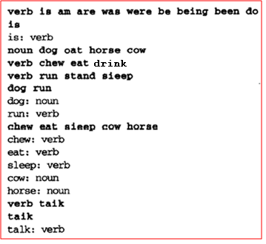
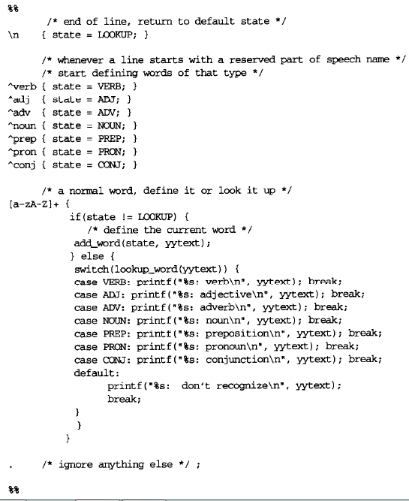
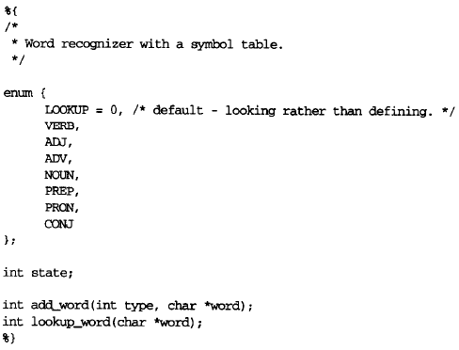
Recognizing parts of speech with Symbol Table

Slide 7
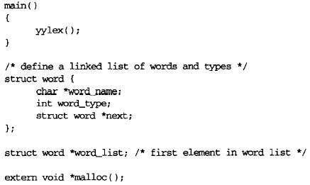
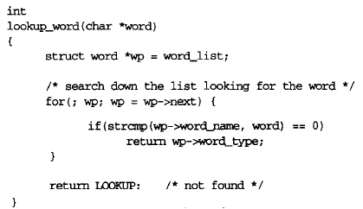
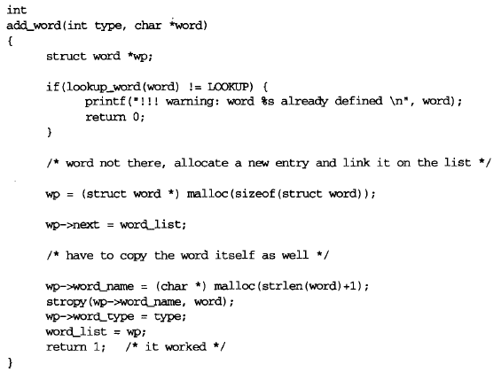

Slide 8
Refer O’Reilly Book – Lex and Yacc
Perform 3b,3d (details given in previous slides)
Submit on VOLP (A3-WEEK2) – please, in 1 single doc file

Slide 9
Thank You!!

